Slide 1
Chapter 8 How to work with data types

Slide 2

SQL server Functions
A Function is a method that can add additional functionality to SQL server statements
You can use functions to get value from the system
Or to provide a quick way to apply capability to an existing value
Ex: getdate() function return the date set on the server where sql server is installed on
Concat(…,…), a different function that takes two or more strings and put them together, that is concatenate them together
Can be used in any part of SQL statement, including clauses and in DML
A function always return a single value
Some function takes no parameters or more depends on a specific function been called
getdate() function takes no parameters, it doesn’t need to get the date on the server VS
Concat(…,…), takes of minimum of two parameters
Function can’t be run stand alone, it must be included in the Select statement

Slide 3
Function Category
These are some of the most commonly used categories in most queries
String
LEN
CONCAT
Conversion
Functions that Convert values from one datatype to another
CONVERT
Logical
Functions that allow logical decision making
IIF
Numeric
ISNUMERIC
Date and Time
ASCII
LTRIM/RTRIM
UPPER/LOWER
etc
CAST
PARSE
Functions allow you to manipulate the string provided as a parameter
CHOOSE
ROUND
RAND
SIN/COS/TAN
Functions that apply to data and time based calculation
GETDATE
DATENAME
DATEPART
DATEDIFF
DATEADD
SPACE
REPLACE

Slide 4
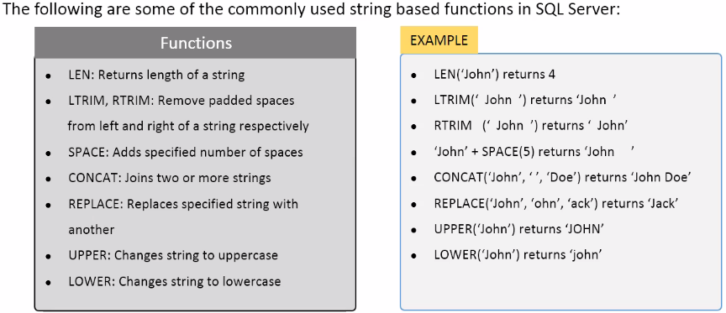
String Functions

Slide 5
Conversion Functions
By default you can’t mix datatypes with a statement
You can’t say Select ProdName+’Cost’+Price, it will give an error.
As you can join the name and the word cost together as they’ve been defined as varchar, the price column can’t be as it is a numeric field
To make sure datatype can work with each other, you need to convert one to the other
There are 2 functions that do this; CAST or CONVERT
The CAST function; it takes the value column to convert and require the AS data type. It will convert into the data type requested
Syntax: CAST(<value>) AS < new datatype >
The CONVERT function; it takes the target data type and the value and does the same thing as the CAST, however, it has 1 more parameter to use which is Style to change the format of the output value
Syntax: CONVERT (<new data type>,<value>[,<style>])

Slide 6
CAST Function
You use CAST function when you want to explicitly specify what data type to change into
Assume we have the following table:
and this table contains the following rows:
we use the CAST function to
convert the Score column from
type FLOAT to INTEGER.
SELECT First_Name,
CAST(Score AS Integer) AS Int_Score
FROM Student_Score
Column Name | Data Type
StudentID | integer
First_Name | char(20)
Score | float
StudentID | First_Name | Score
1 | Jenny | 85.2
2 | Bob | 92.5
3 | Alice | 90
4 | James | 120.1
First_Name | Int_Score
Jenny | 85
Bob | 92
Alice | 90
James | 120

Slide 7
CAST Function
Here, we use the CAST function to convert the SCORE column from type FLOAT to CHAR(3). When we do this, we only take the first 3 characters. So, if there are more than 3 characters, everything after the first 3 characters is discarded
SELECT First_Name, CAST(Score AS char(3)) AS Char_Score
FROM Student_Score
Result:
First_Name | Char_Score
Jenny | 85.
Bob | 92.
Alice | 90
James | 120

Slide 8
CONVERT function
As we discussed in earlier slides; CONVERT function is very similar to the CAST function in that they both change the value from one data type to another.
Using the same table but with Convert
SELECT First_Name, CONVERT(Integer, Score, ) AS Int_Score
FROM Student_Score
Result:
First_Name | Int_Score
Jenny | 85
Bob | 92
Alice | 90
James | 120

Slide 9
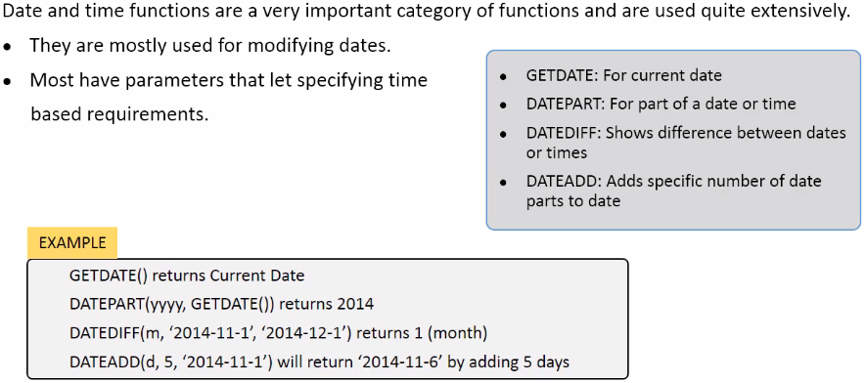
Date and Time Functions
How many month left till thanksgiving
Select DATEDIFF(mm,getdate(),'11/24/2019')
Check Chapter 3

Slide 10
Convert and format dates
The CONVERT() function can be used to display date/time data in different formats.
Syntax: CONVERT(data_type(length),expression,style) =====> 3 Parameters
datatype(length): Specifies the target data type (with an optional length)
expression : Specifies the value to be converted
style : Specifies the output format for the date/time

Slide 11
The following script uses the CONVERT() function to display different formats. We will use the GETDATE() function to get the current date/time:
Select CONVERT(varchar(20),getdate()) AS 'Default Style'====> default mon dd yyyy hh:miAM (or PM)
Select CONVERT(VARCHAR(20),GETDATE(),101) AS 'Style 101' =====> mm/dd/yyyy US
Select CONVERT(VARCHAR(10),GETDATE(),10) AS 'Style 10' =====> mm-dd-yy
Select CONVERT(VARCHAR(10),GETDATE(),110) AS 'Style 110' =====> mm-dd-yyyy
Select CONVERT(VARCHAR(11),GETDATE(),6) AS 'Style 6' =====> dd mon yy
Select CONVERT(VARCHAR(11),GETDATE(),106) AS 'Style 106' =====> dd mon yyyy
Select CONVERT(VARCHAR(24),GETDATE(),113) AS 'Style 113' =====> dd mon yyyy hh:mi:ss:mmm (24h)
--NOTE: Length is OPTIONAL SO they all can be written without capping the size
Select CONVERT(varchar,getdate()) AS 'Default Style‘ ====> default mon dd yyyy hh:miAM (or PM)
Select CONVERT(VARCHAR,GETDATE(),101) AS 'Style 101' ====> mm/dd/yyyy US
Select CONVERT(VARCHAR,GETDATE(),10) AS 'Style 10' ====> mm-dd-yy
Select CONVERT(VARCHAR,GETDATE(),110) AS 'Style 110' ====> mm-dd-yyyy
Select CONVERT(VARCHAR,GETDATE(),6) AS 'Style 6' ====> dd mon yy
Select CONVERT(VARCHAR,GETDATE(),106) AS 'Style 106' ====> dd mon yyyy
Select CONVERT(VARCHAR,GETDATE(),113) AS 'Style 113' ====> dd mon yyyy hh:mi:ss:mmm (24h)

Slide 12
Chapter 9 Utilizing few Functions

Slide 13
Different ways to replace NULL values
Three ways to replace NULL values in DB
Select ISNULL(Null, ‘Missing Value')
Select Coalesce(Null, ‘Missing Value')
Select case when fname is null then ‘Missing Value' Else fname End AS Name
From Emp
ISNULL()
Is the easiest function to replace a null value with a desired value
Syntax: Select ISNULL(expression or column name, new value ) AS ColName
CASE()
Syntax: Case when expression Then ‘ ‘ Else ‘ ‘ END
COALESCE()
Is used to return 1st non null value
Syntax: select coalesce(Col, NewValue')

Slide 14
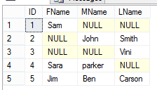
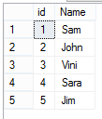
Utilizing few Functions
COALEASCE():
It’s a function that returns the 1st non null value OR
It’s a function to replace the Null values in the DB
Take a look on the following Emp table
If you want to display an output as
Id and Name
Without any NULL, you will need to use Coalesce
select id, coalesce(fname,MName,LName) AS Name
from emp

